Slide 1

2026 Soccer Program

Slide 2
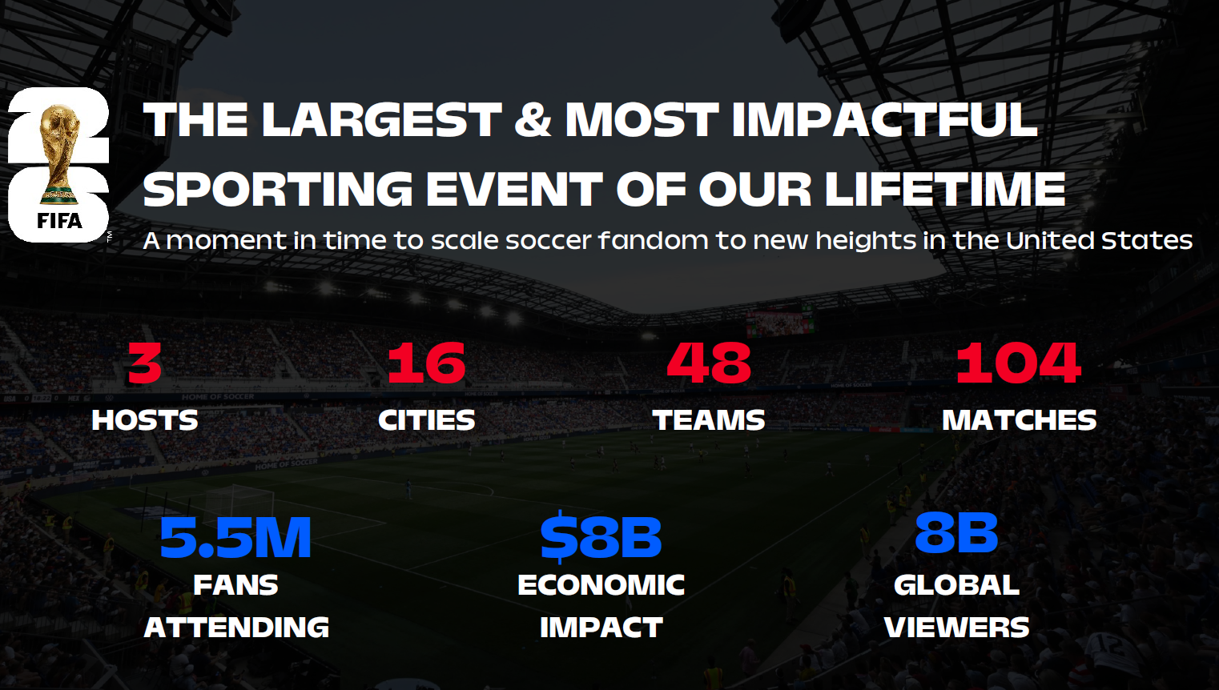
2026 FIFA World Cup
The 2026 edition of the World Cup will kick off in mid-June in host cities across the US, Canada & Mexico.
The tournament has been expanded to include 48 teams for the first time (up from 32 historically), so it will be the biggest World Cup yet!
Final will be played on July 19, 2026, in New York/New Jersey

Slide 3
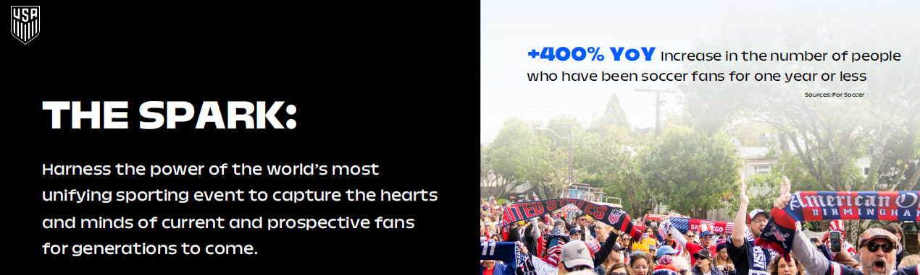
US Soccer Federation License
Soccer is a growing sport with an expanding fan base in the U.S. and Hoffmaster is excited to partner with the US Soccer Federation to provide licensed partyware for the 2026 World Cup.
US Soccer will have partnerships across a large variety of product categories and all channels of retail – don’t miss out on capitalizing on this premier event!
Hoffmaster’s program of US Soccer-licensed product, along with general soccer items provides an opportunity to support all fan bases!

Slide 4
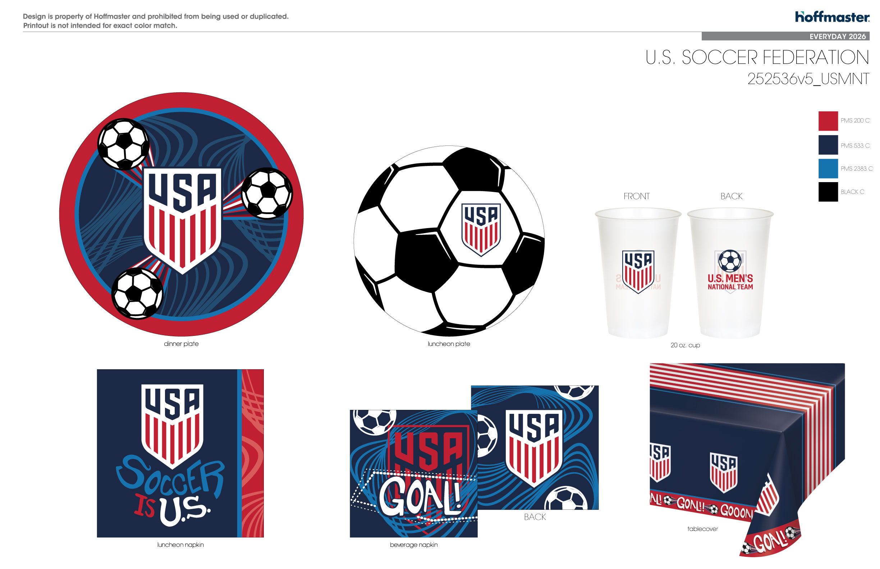
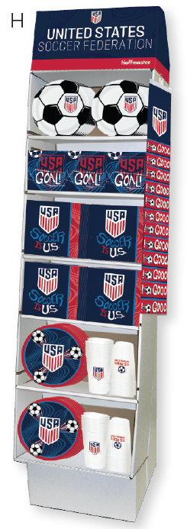
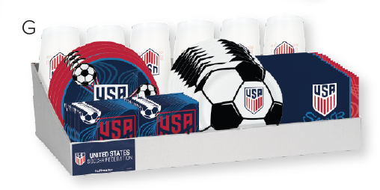
US Soccer Licensed Assortment
Hoffmaster’s online distribution policy prohibits customers from selling USSF product on third party websites such as Amazon.com, Ebay, etc. Customer may sell USSF product on their own website, provided that the customer maintains complete control of the transactional environment.

Slide 5

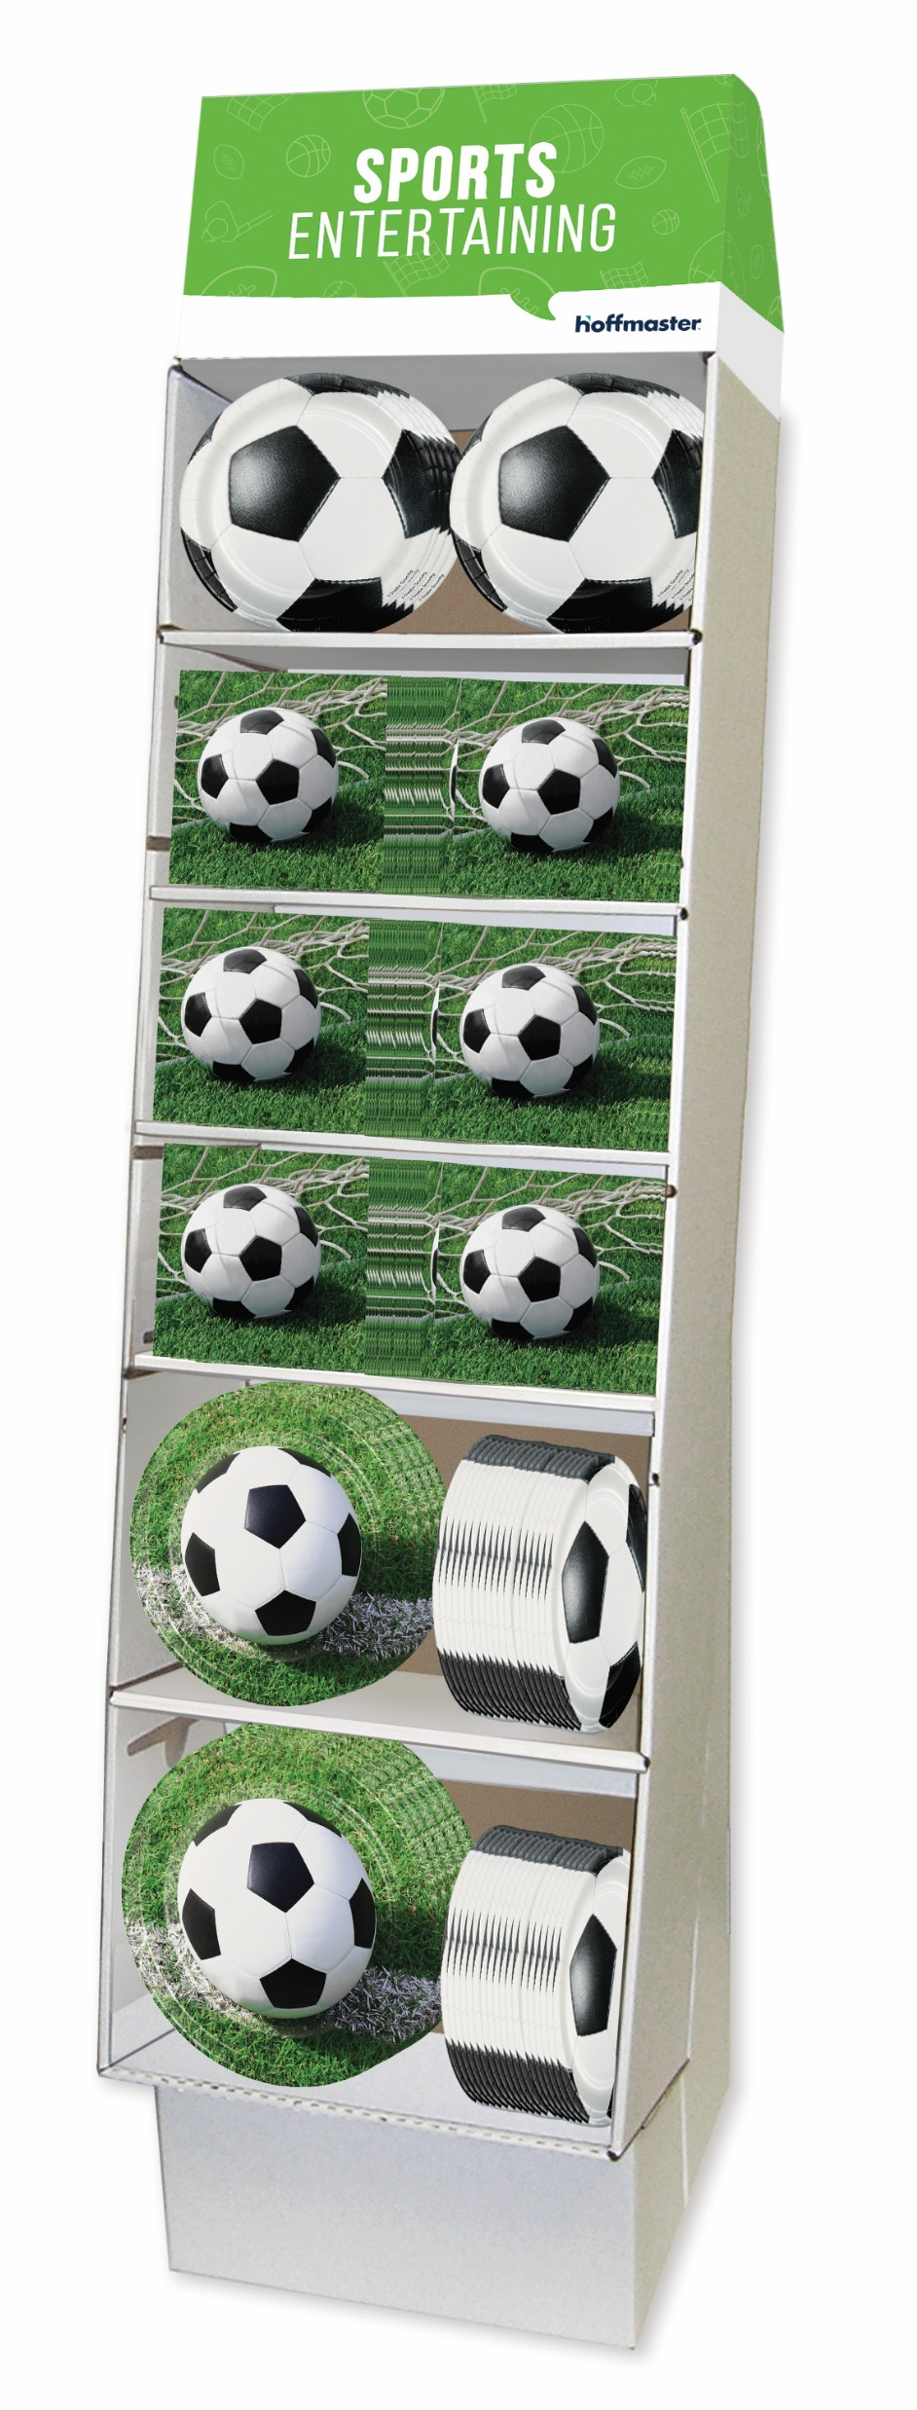



General Soccer Assortment

Slide 6
Program Timeline
December 1, 2025 – Customer order commitments due
March 1, 2026 – Shipping begins
June 11, 2026 – First match of WC26 begins
July 19, 2026 – Final match of WC26 (New York/New Jersey)

Slide 7
Host Cities & Match Dates
Atlanta
June 15, 18, 21, 24, 26
July 1, 7, 15
Boston
June 13, 16, 19, 23, 26, 29
July 9
Dallas
June 14, 17, 22, 25, 27, 30
July 3, 6, 14
Houston
June 14, 17, 20, 23, 26, 29
July 4
Kansas City
June 16, 20, 25, 27
July 3, 11
Los Angeles
June 12, 15, 18, 21, 25, 28
July 2, 10
Miami
June 15, 21, 24, 27
July 3, 11, 18
New York/New Jersey
June 13, 17, 22, 24, 26, 30
July 5, 19 (Final Match)
Philadelphia
June 14, 19, 22, 25, 27
July 4
Seattle
June 15, 19, 24, 26
July 1, 6
San Francisco Bay Area
June 13, 16, 19, 22, 25
July 1
Toronto
June 12, 17, 20, 23, 26
July 2
Vancouver
June 13, 18, 21, 24, 26
July 2, 7
Guadalajara
June 11, 18, 23, 26
Mexico City
June 11 (Opening Match), 17, 24, 30
July 5
Monterrey
June 14, 20, 24, 29

Slide 8

U.S. Men’s Team Schedule
Group Stage Schedule
June 12 – Los Angeles, CA
June 19 – Seattle, WA
June 25 – Los Angeles, CA
Round of 32
If the team moves on to this round, they will most likely play the first week of July

Slide 9
