Slide 1
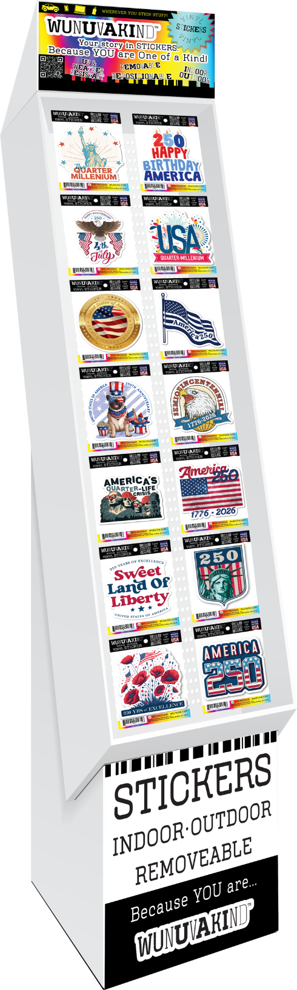
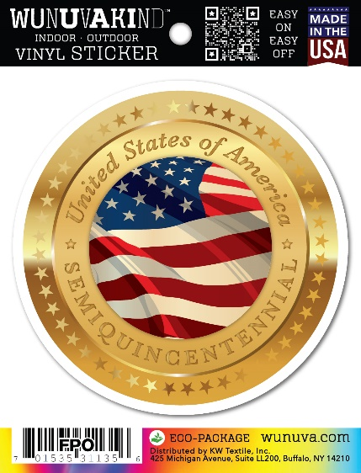
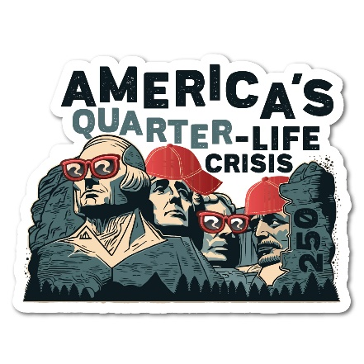

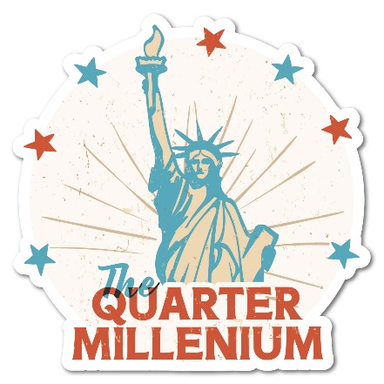
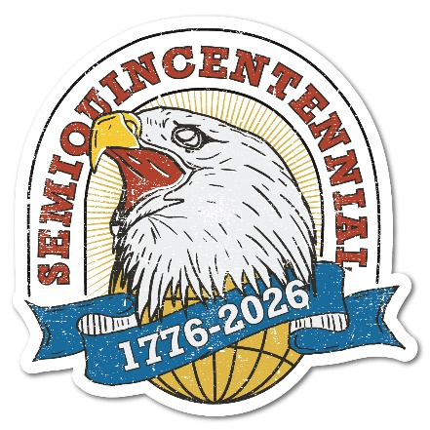
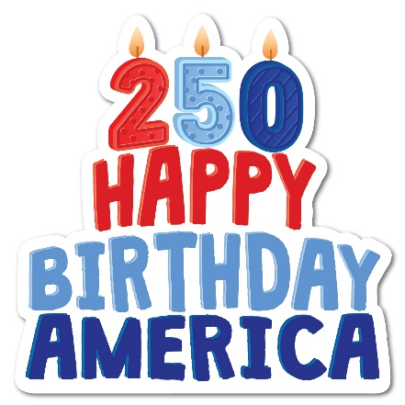
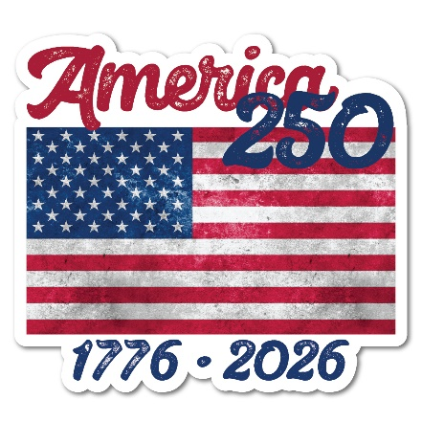
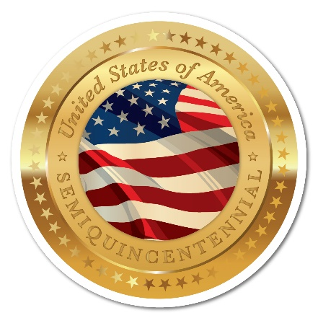
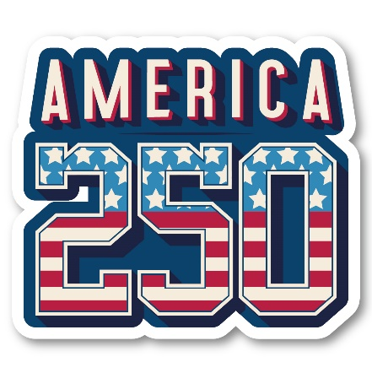
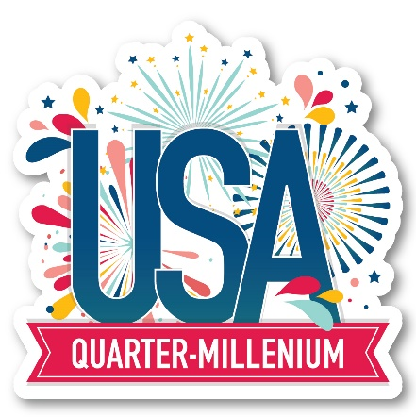

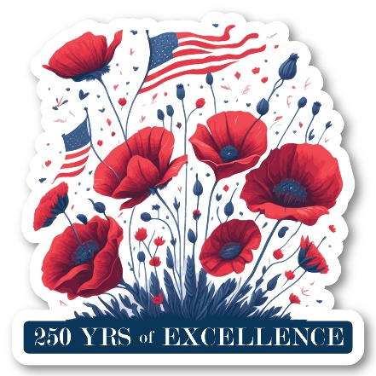
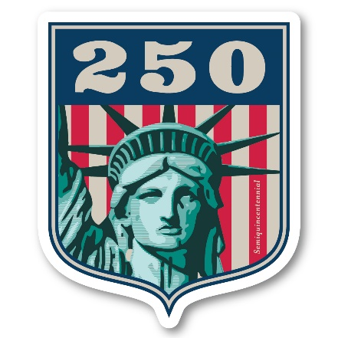

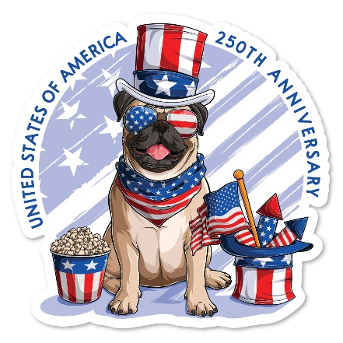
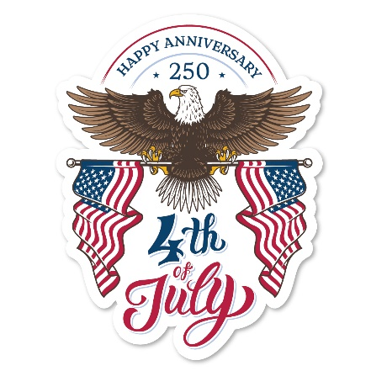


WUNUVAKIND™ ECO STICKERS • AMERICA250
USA 250 STICKER DISPLAY
140 - 4” STICKERS
DP-163 | Quarter Life Crisis
Dp-164 | Waving Flag
DP-165 | Quarter Millennium Liberty
DP-166 | Semiquincentennial Eagle
DP-167 | Happy Birthday America Cake
DP-168 | Vintage Flag
DP-169 | Semiquin Gold Seal Flag
KM-040 | Stars and Stripes 250
KM-043 | USA Fireworks
KM-044 | Years of Excellence Poppies
KM-046 | Statue of Liberty Crest
SP-372 | Sweet Land of Liberty
SP-373 | Patriotic Dog
SP-374 | 4th of July Eagle

