Slide 1
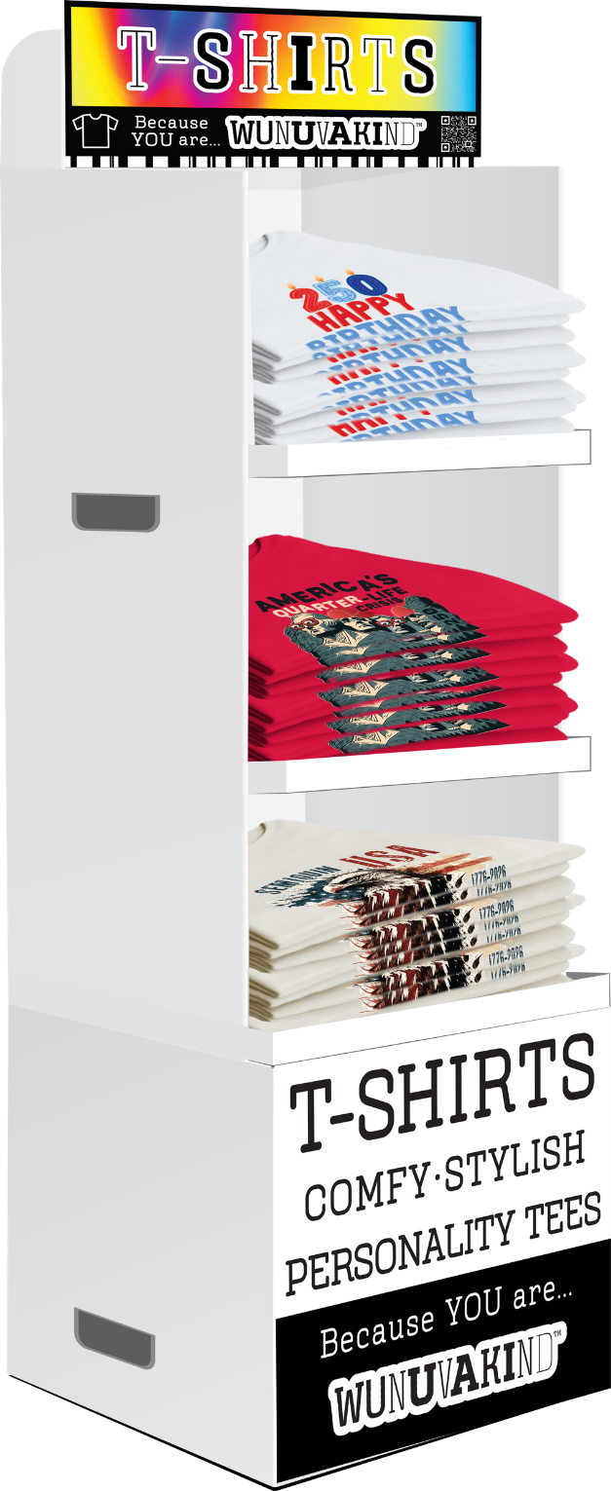
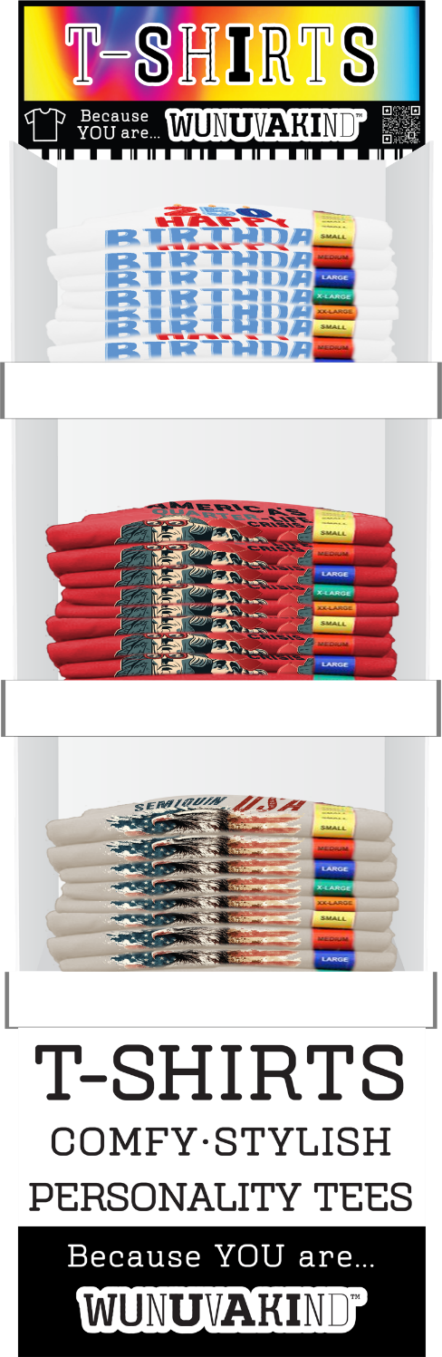
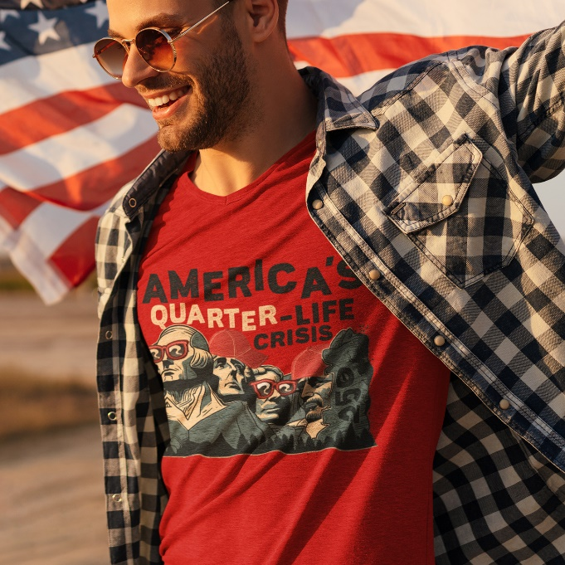
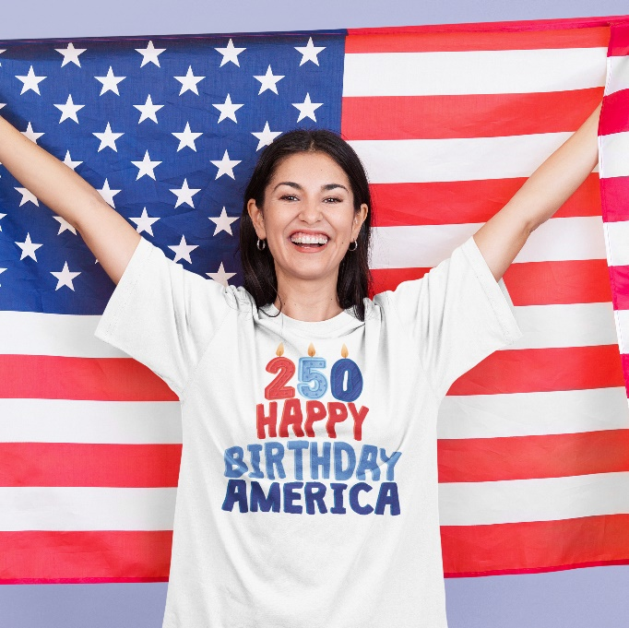
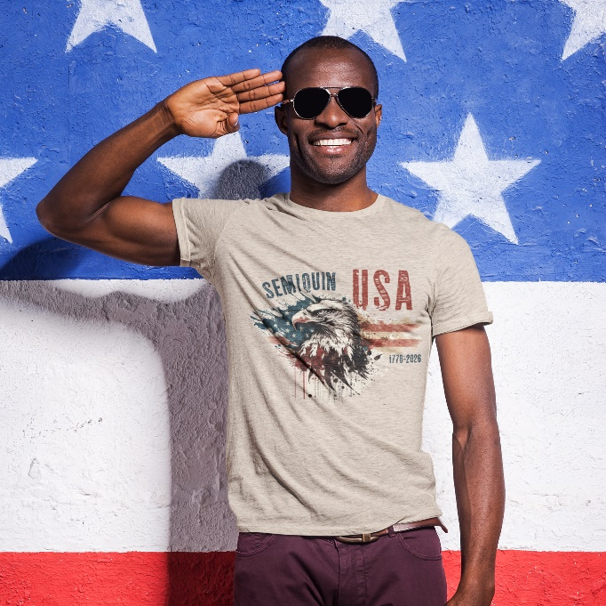
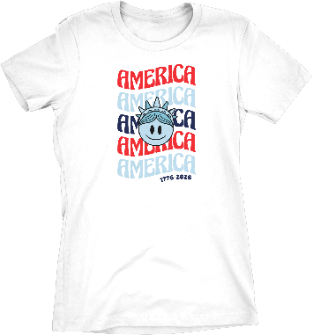
WUNUVAKIND™ PERSONALITY T-SHIRTS • AMERICA250
DPT-045 | Quarter Millennium Liberty
DPT-047 | Honoring Served Eagle
DPT-044 | Vintage Semiquin Eagle

