Slide 1
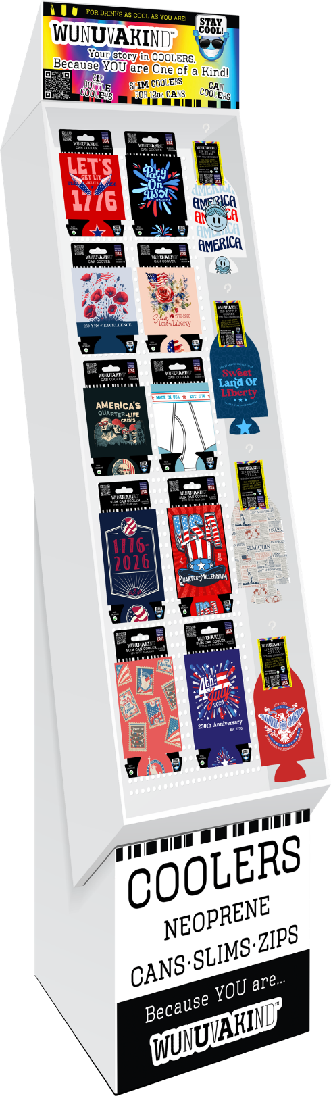
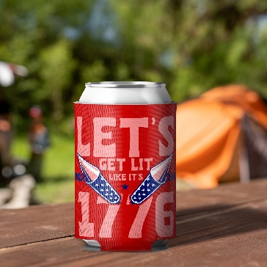
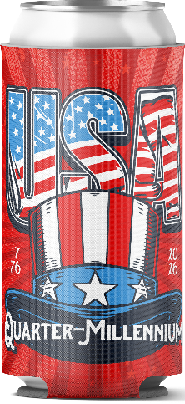
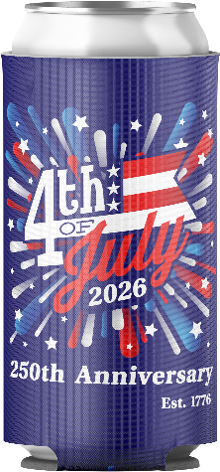
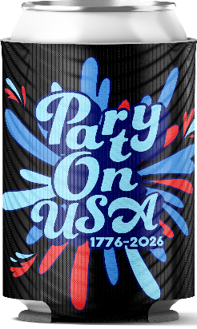
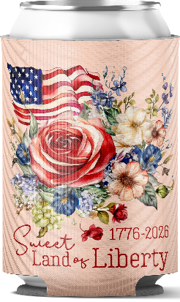
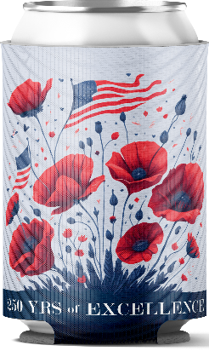
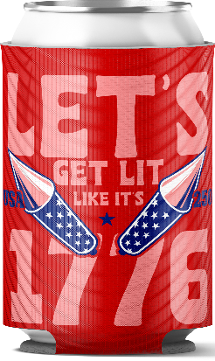
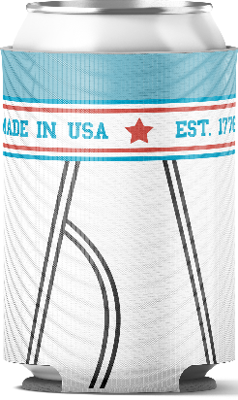
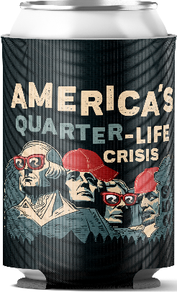
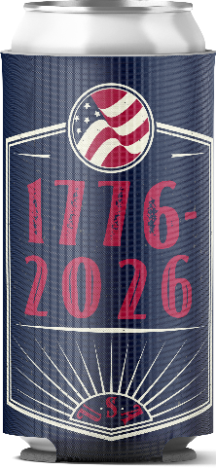
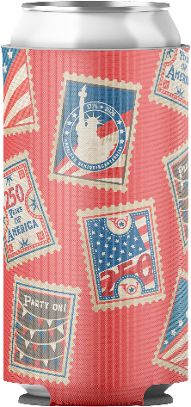
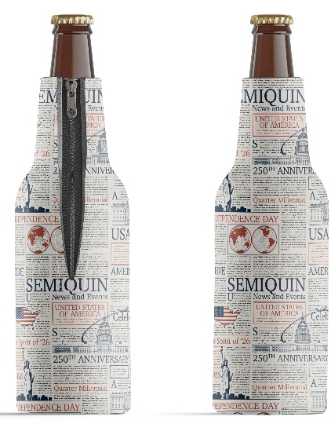
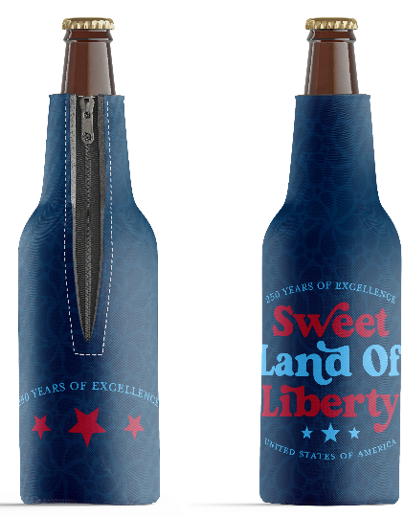
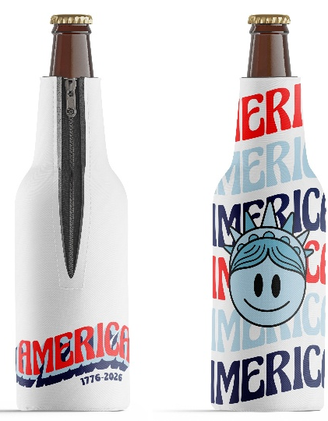
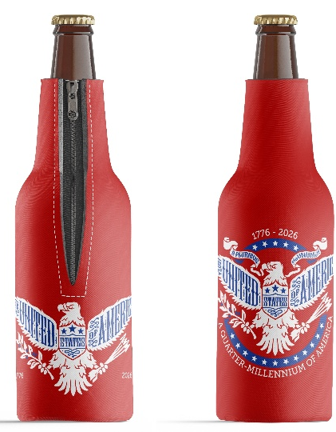
WUNUVAKIND™ NEOPRENE COOLERS • AMERICA250
USA 250 COOZIE DISPLAY
24 BOTTLE SUITS
36 CAN COOLERS
24 SLIM CAN COOLERS
DPH-007 | Uncle Sam Hat
DPH-014 | 4th of July
DPH-012 | Party On USA
DPH-016 | Floral Liberty
DPH-017 | 250 Years of Excellence
DPH-021 | Lit Like 1776
DPH-023 | Made in USA Underwear
DPH-013 | Quarter Life Crisis
DPH-015 | 1776-2026
DPH-009 | Stamps
DPH-011 | SemiQuinu Newspaper
DPH-010 | Sweet Land of Liberty
DPH-018 | Cartoon Liberty
DPH-019 | Eagle Seal

