Slide 1


Top Sellers Program
Presented By

Slide 2
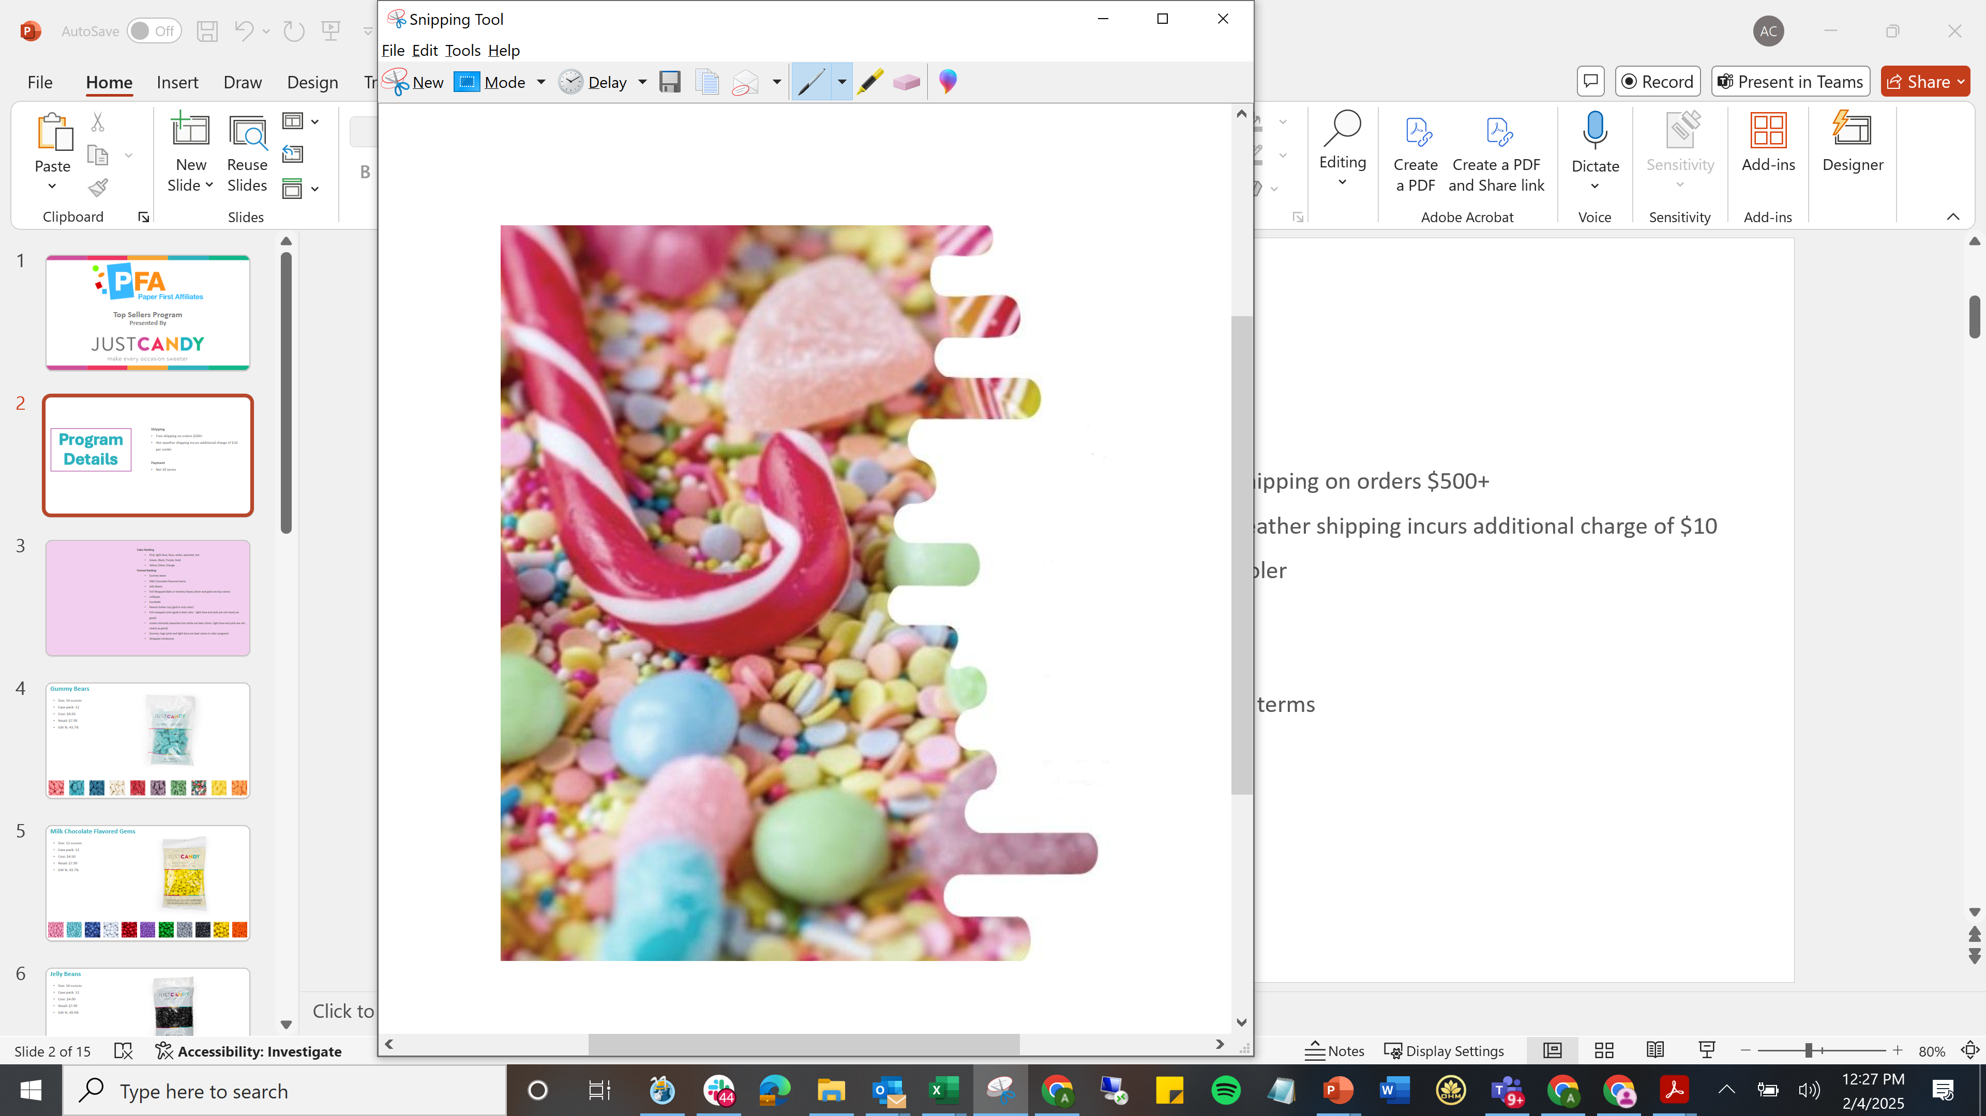
PROGRAM
DETAILS
Shipping
Free shipping on orders $500+
Hot weather shipping incurs additional charge of $10 per cooler
Payment
Net 30 terms

Slide 3
PROGRAM
DETAILS
Color Ranking
  Pink, light blue, blue, white, assorted, red
  Green, Black, Purple, Gold
  Yellow, Silver, Orange
Format Ranking
  Gummy bears
  Milk Chocolate Flavored Gems
  Jelly Beans
  Foil Wrapped Balls or Hershey Kisses (silver and gold are top colors)
  Lollipops
  Gumballs
  Peanut butter cup (gold is only color)
  Foil wrapped coins (gold is best color. Light blue and pink are not nearly as good)
  Jordan Almonds (assorted and white are best colors. Light blue and pink are not nearly as good)
  Gummy rings (pink and light blue are best colors in color program)
  Wrapped miniatures

Slide 4
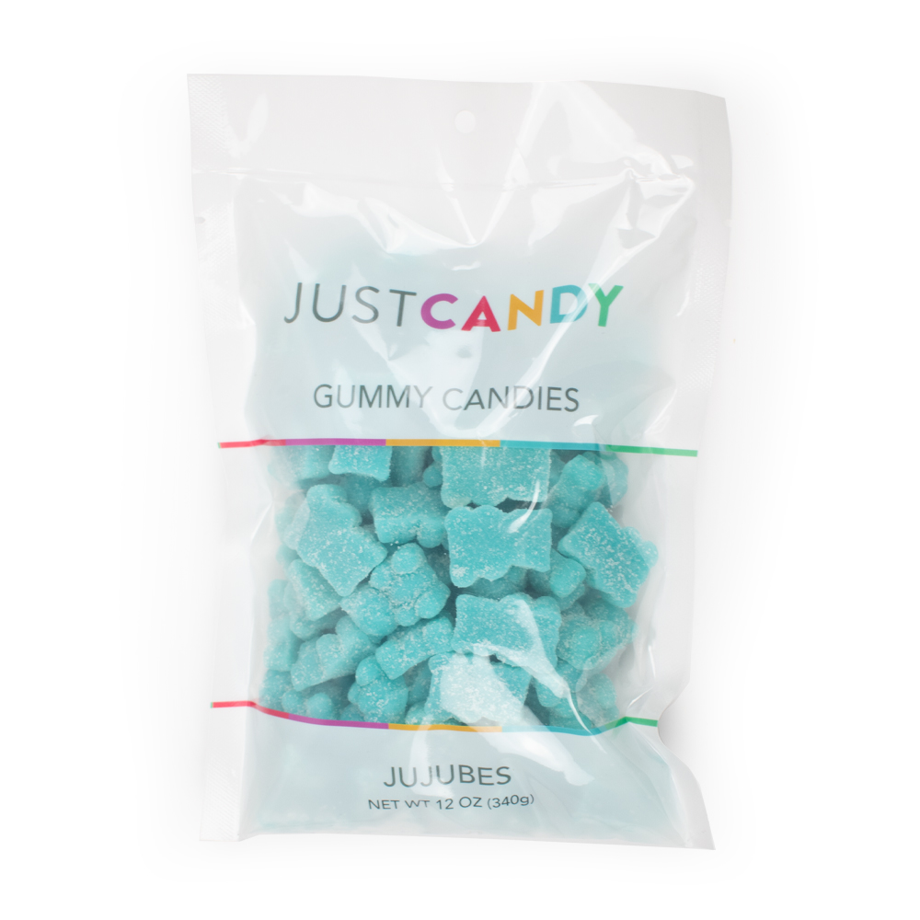
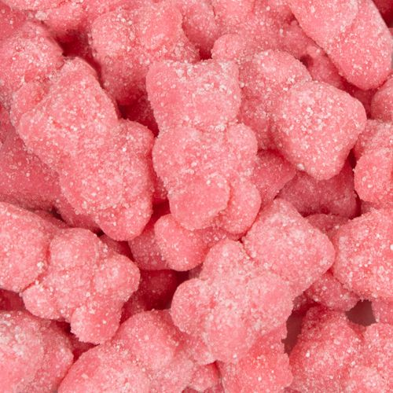
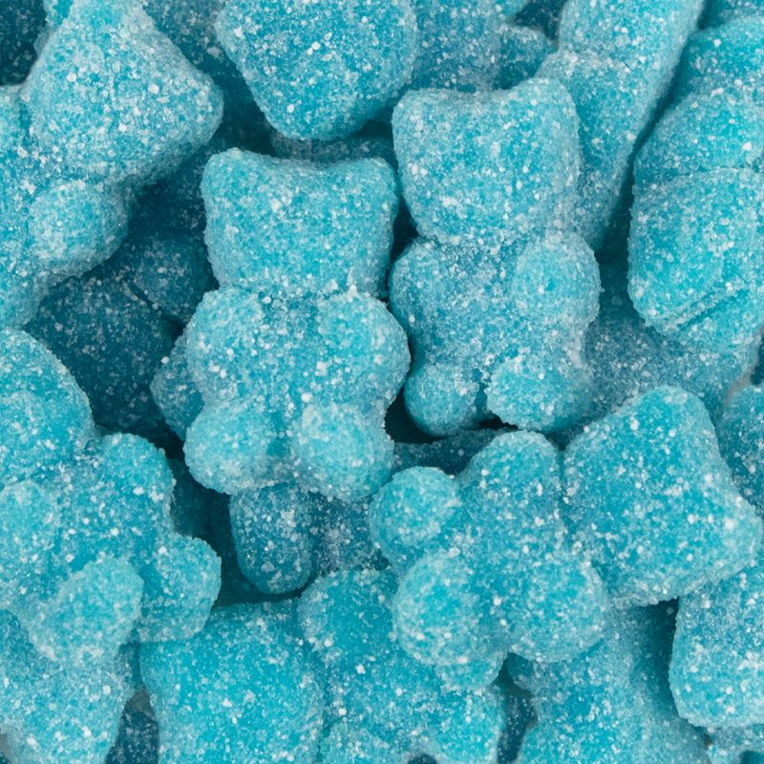
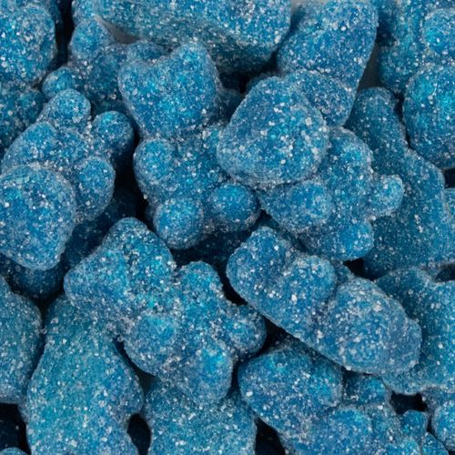
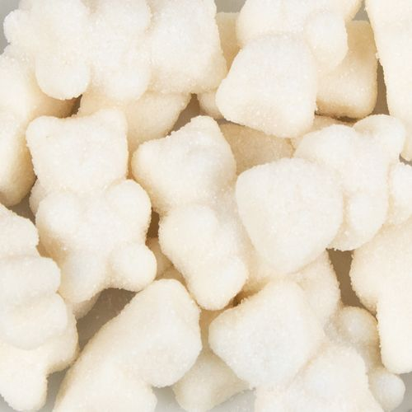
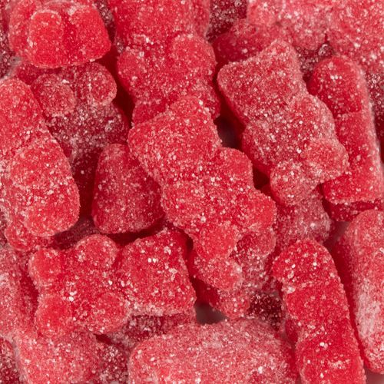
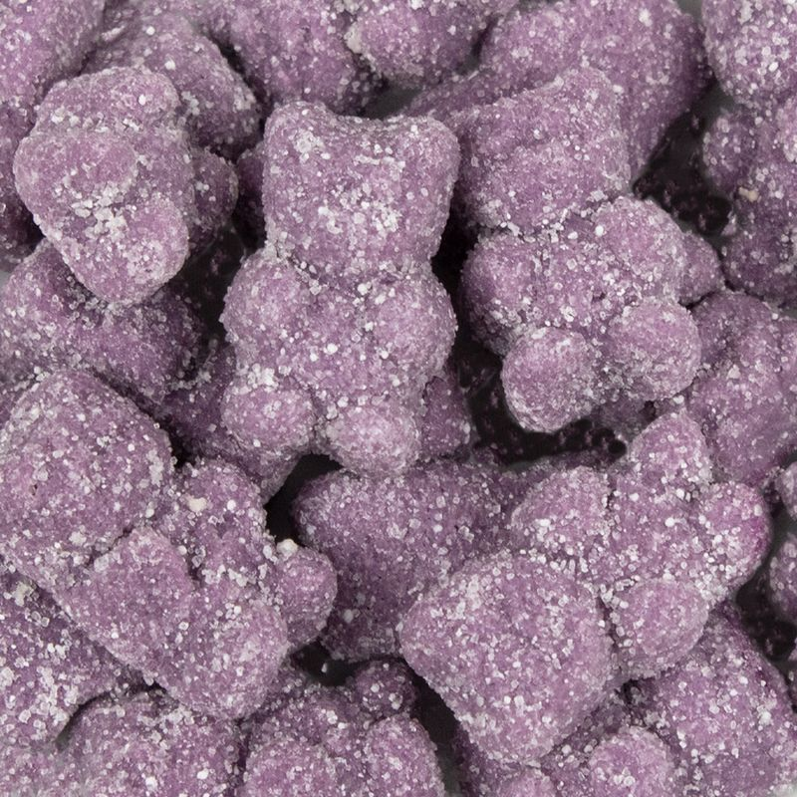
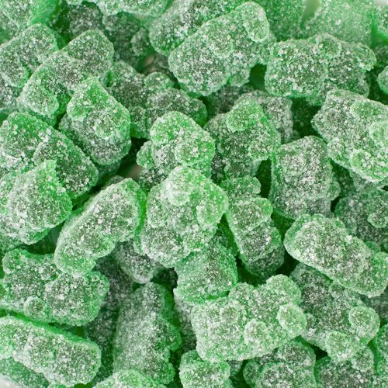
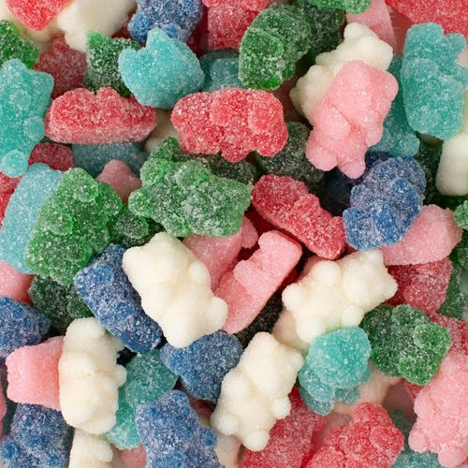
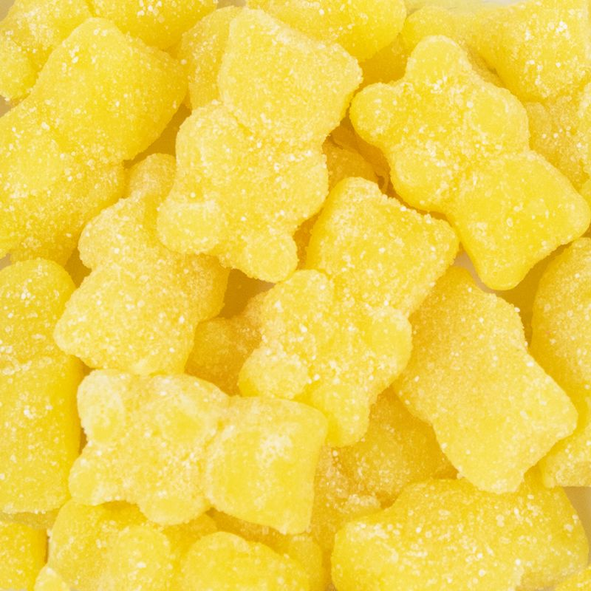
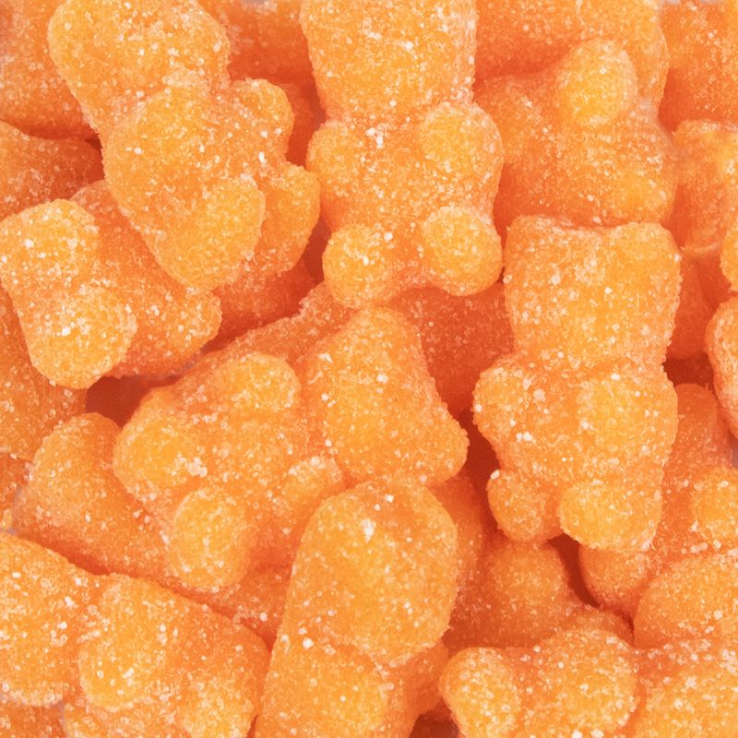
Gummy Bears
Size: 14 ounces
Case pack: 12
Cost: $4.50
Retail: $7.99
GM %: 43.7%

Slide 5
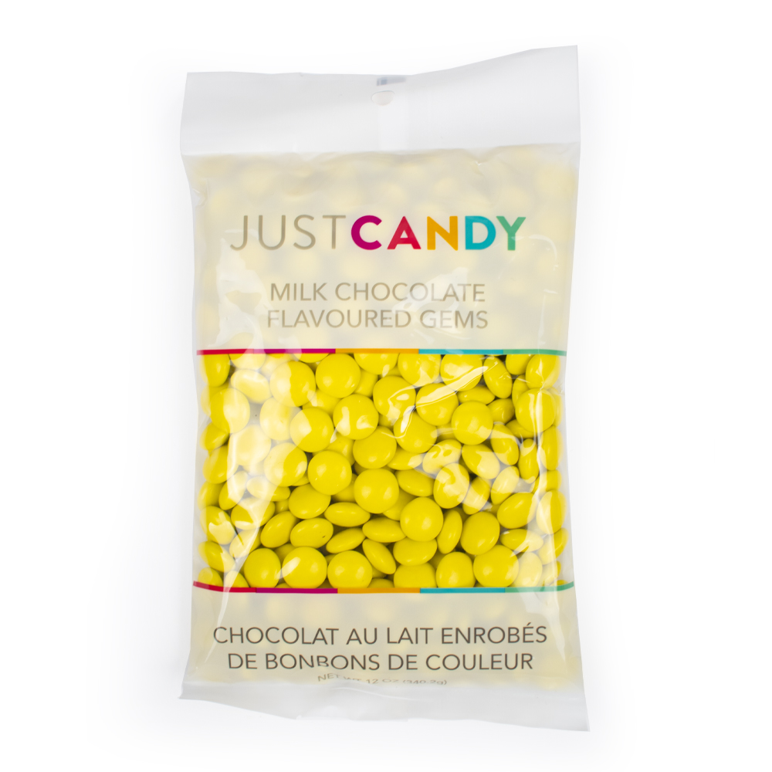
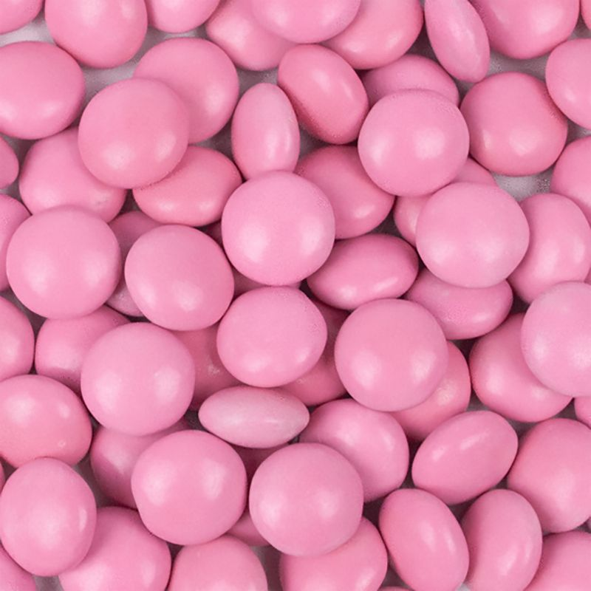
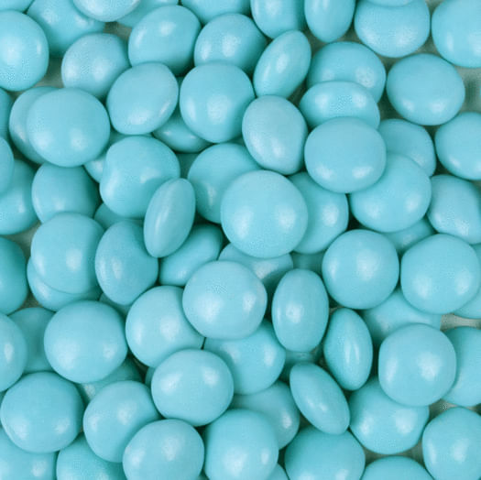
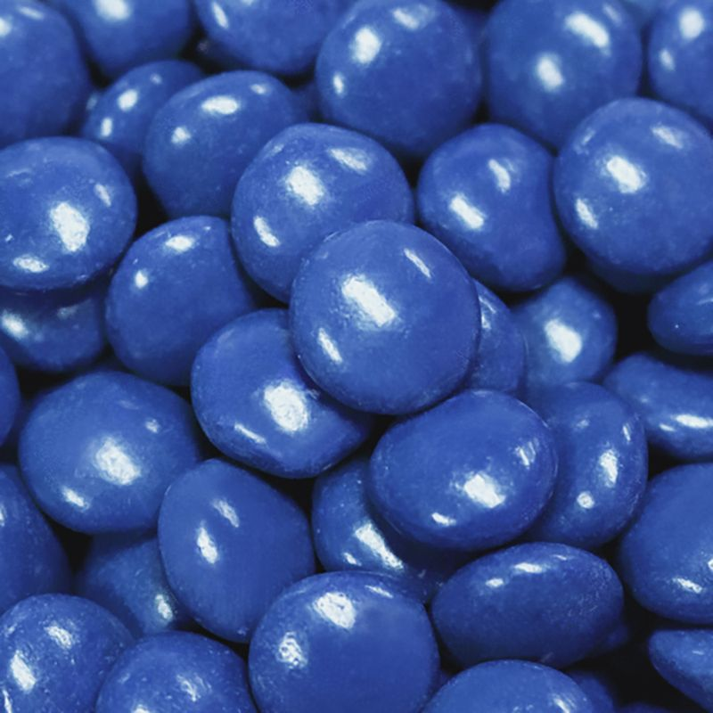
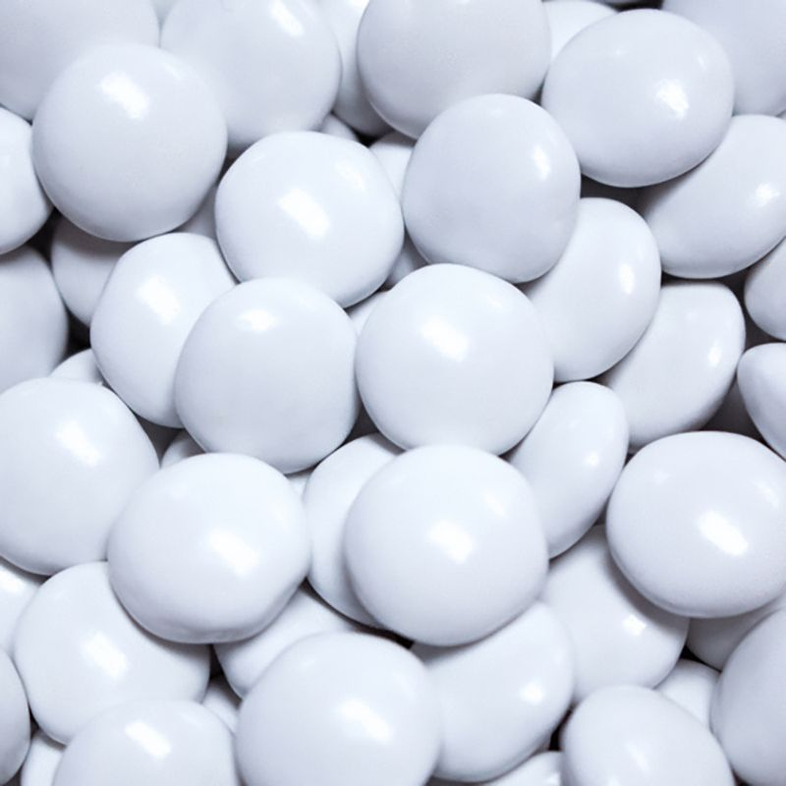
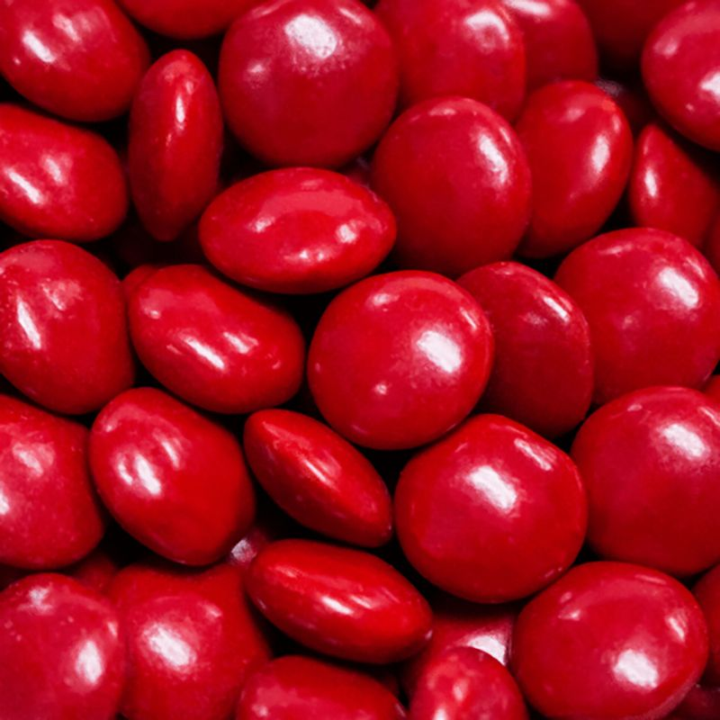
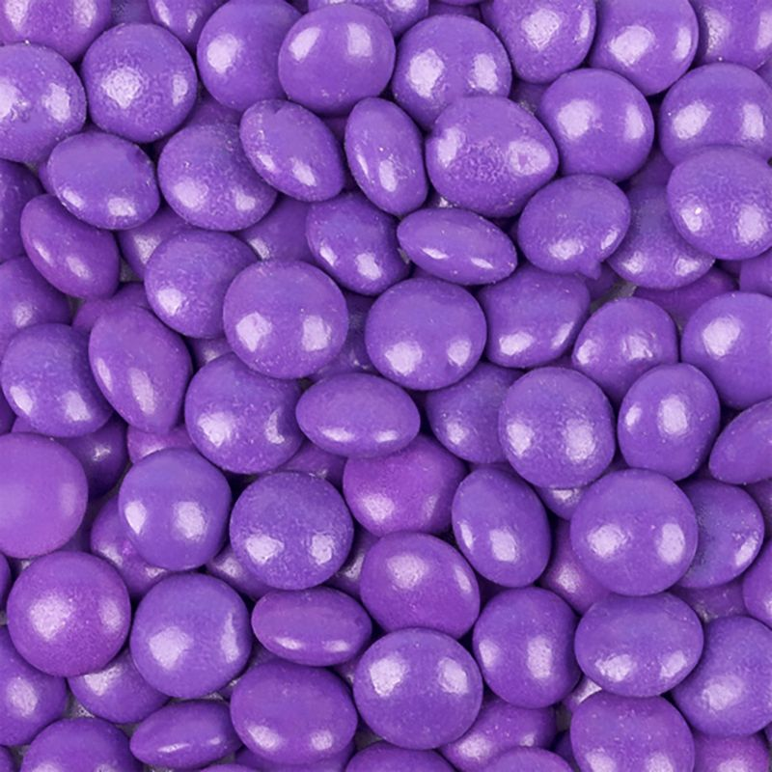
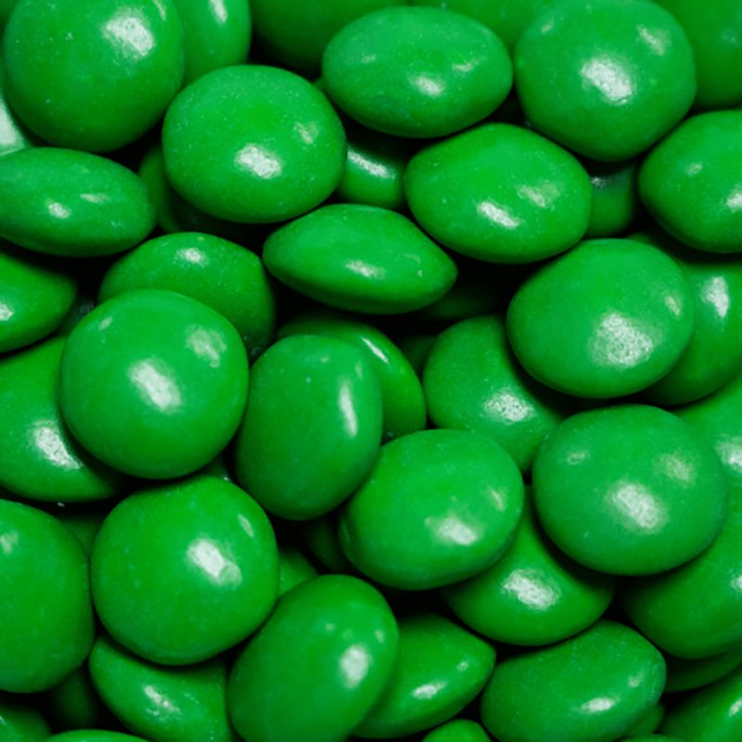
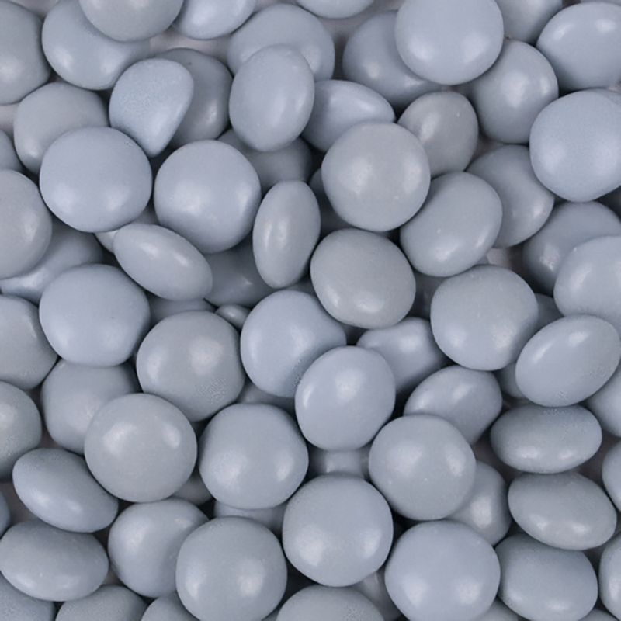
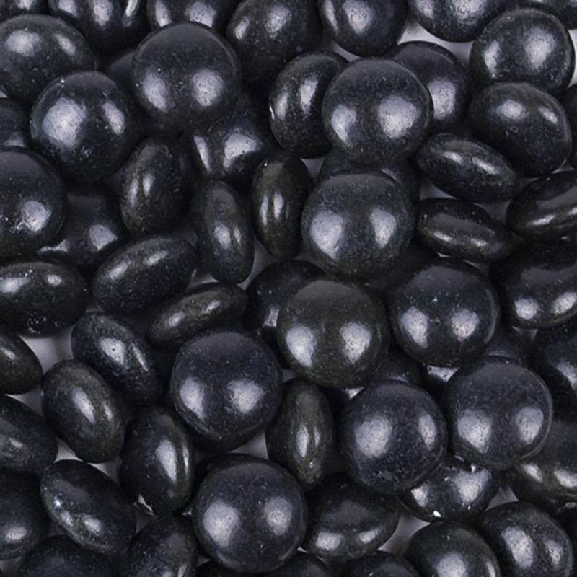
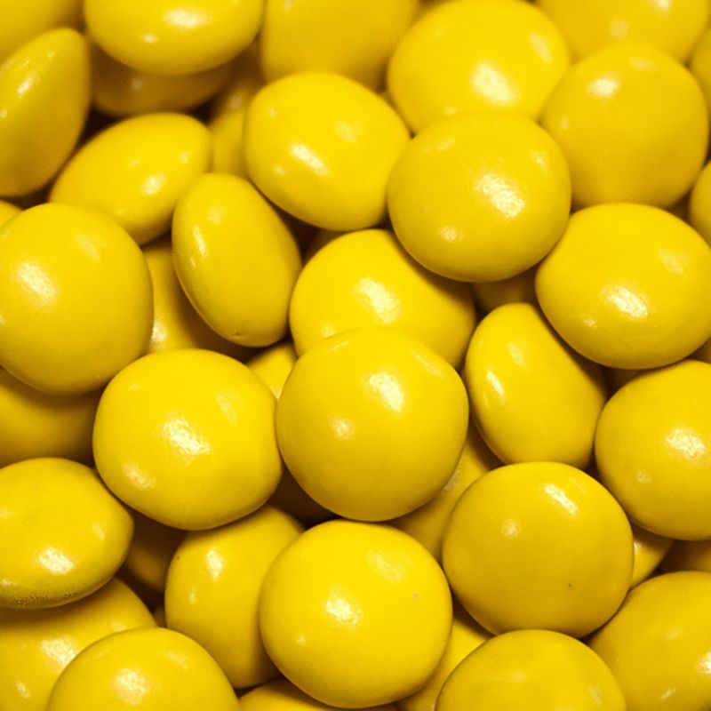
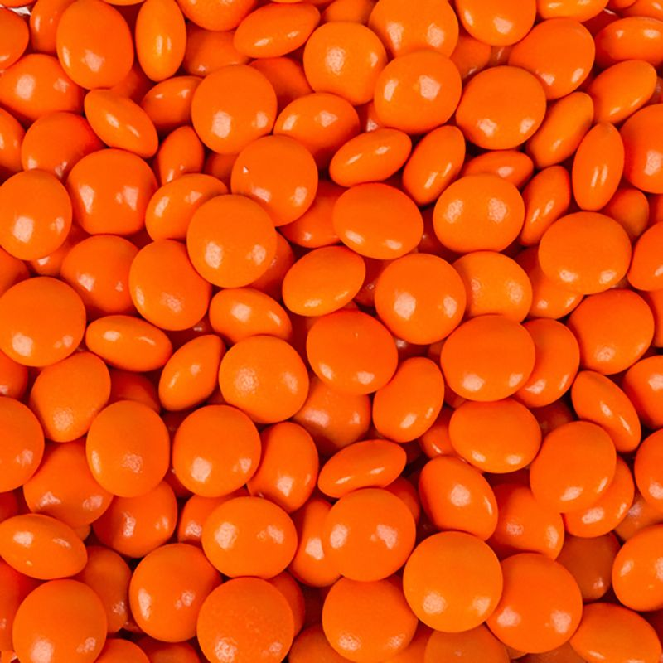
Milk Chocolate Flavored Gems
Size: 12 ounces
Case pack: 12
Cost: $4.50
Retail: $7.99
GM %: 43.7%

Slide 6
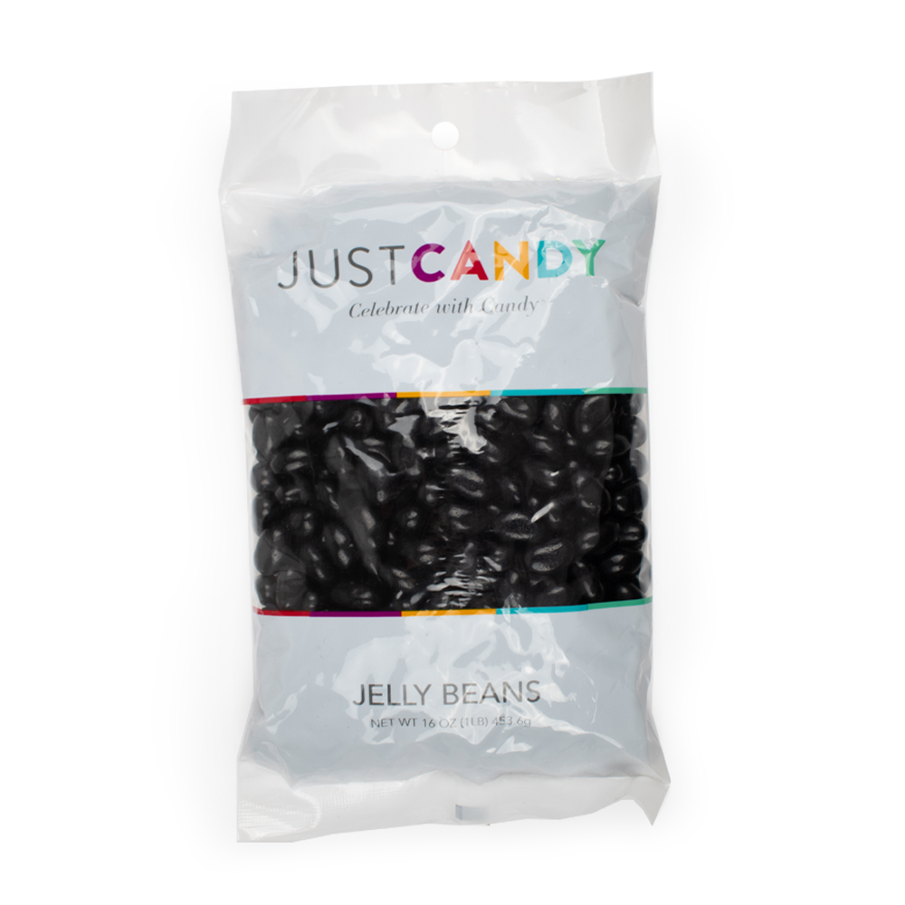
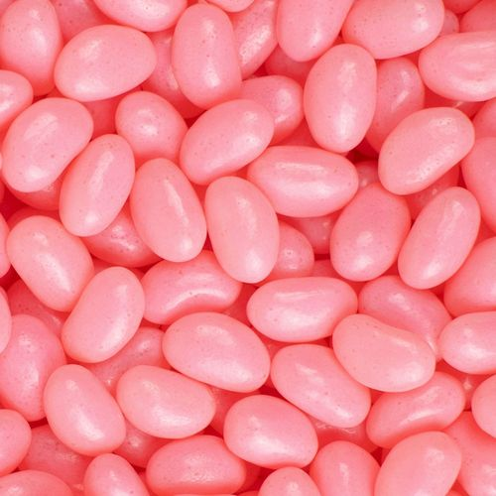
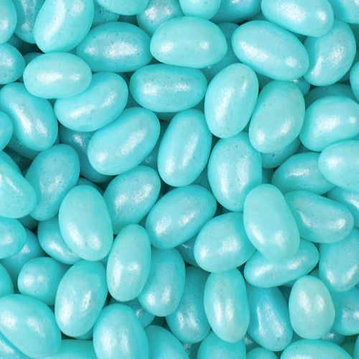
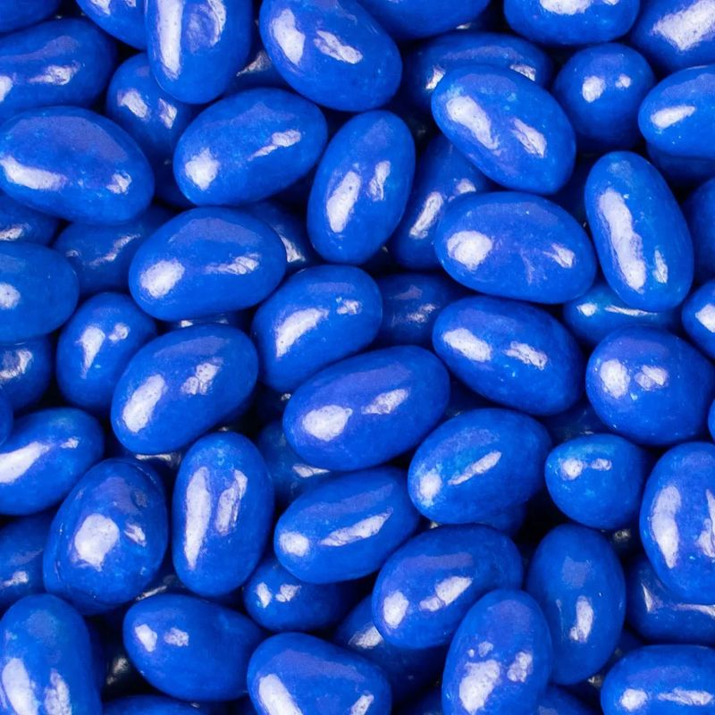
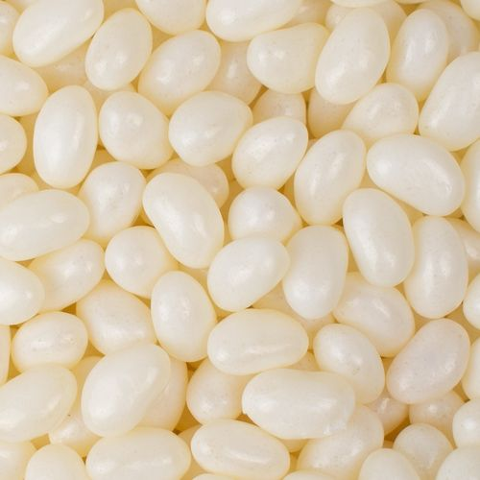
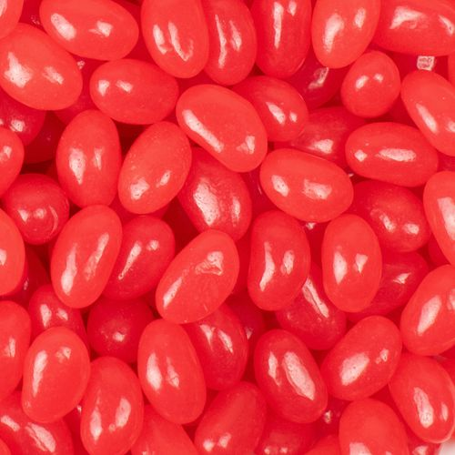
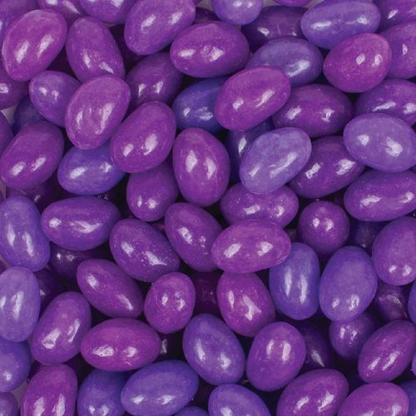
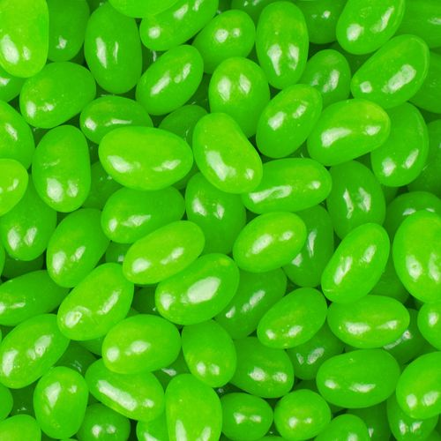
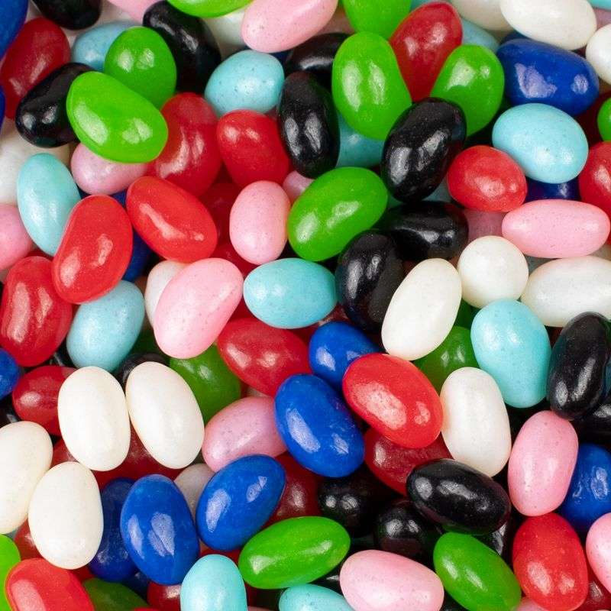
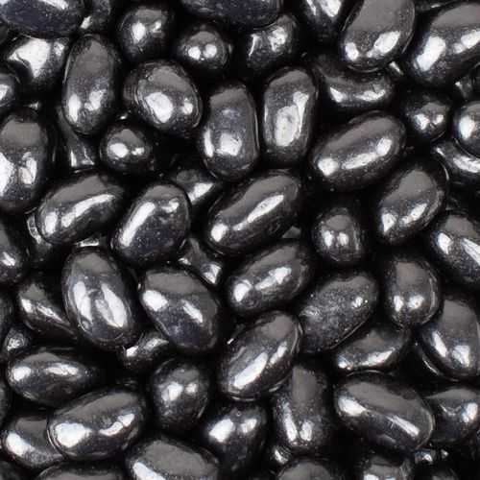
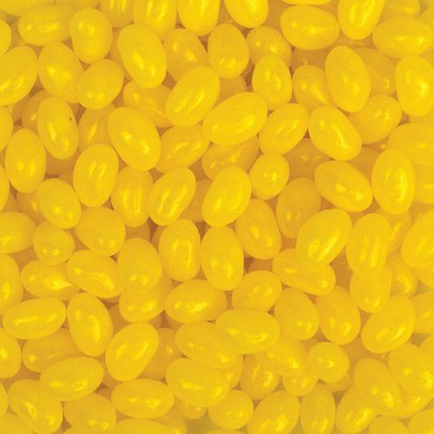
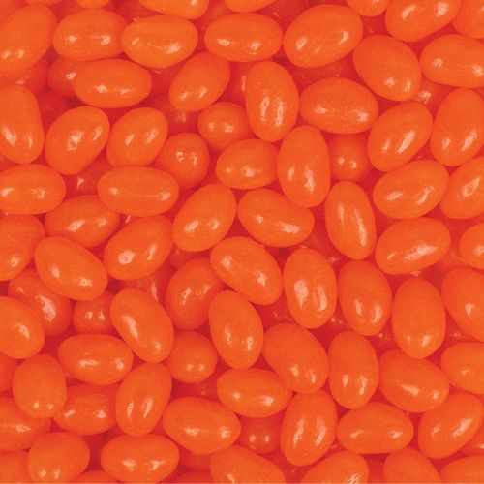
Jelly Beans
Size: 16 ounces
Case pack: 12
Cost: $4.00
Retail: $7.99
GM %: 49.9%

Slide 7
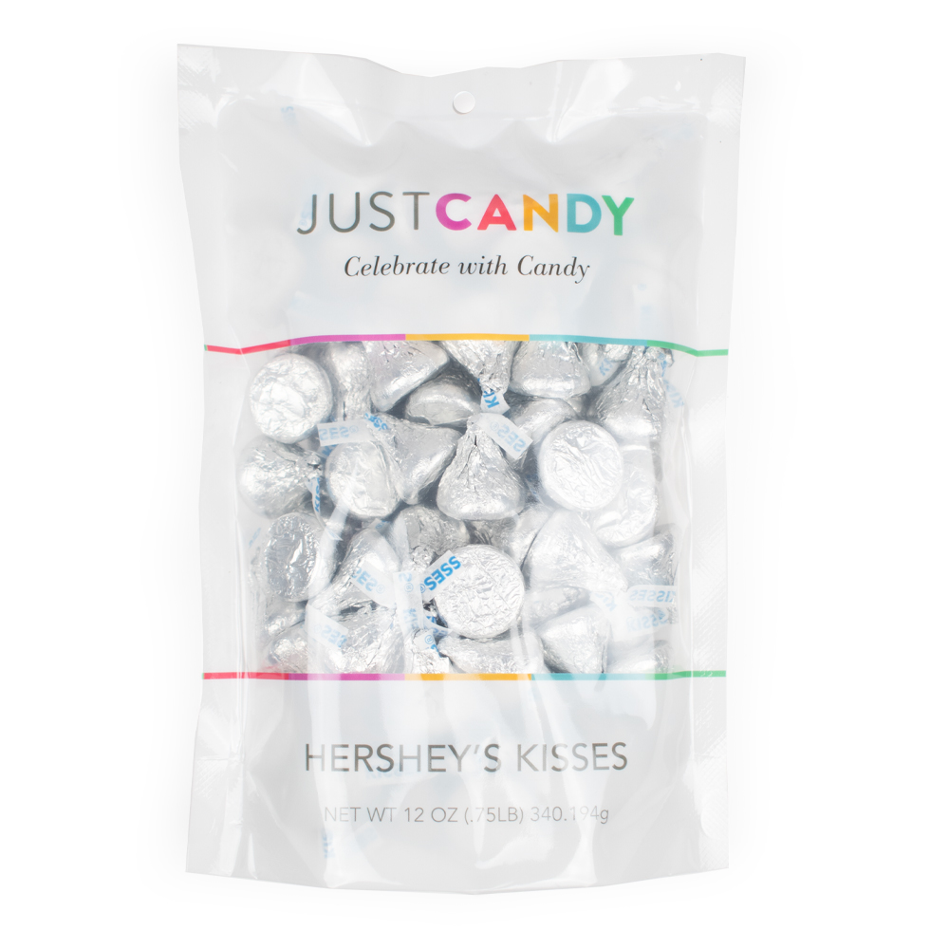
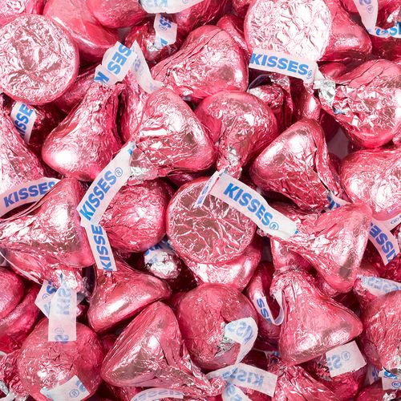
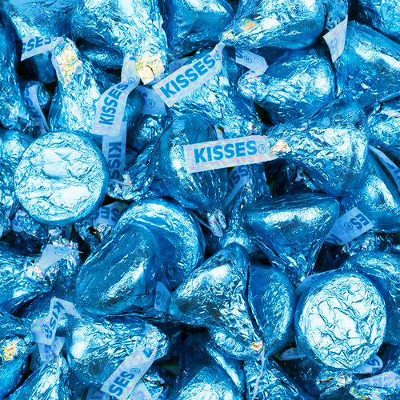
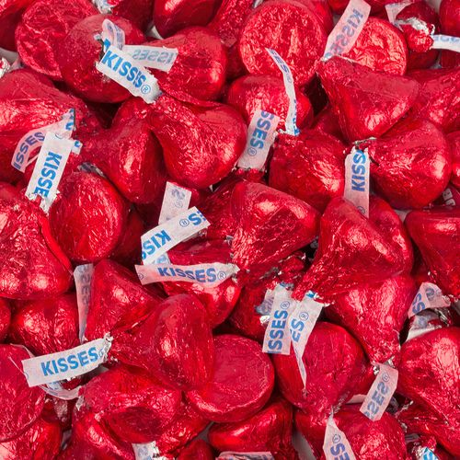
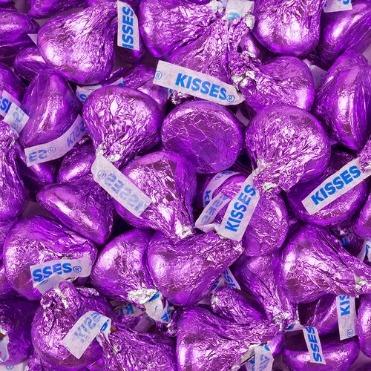
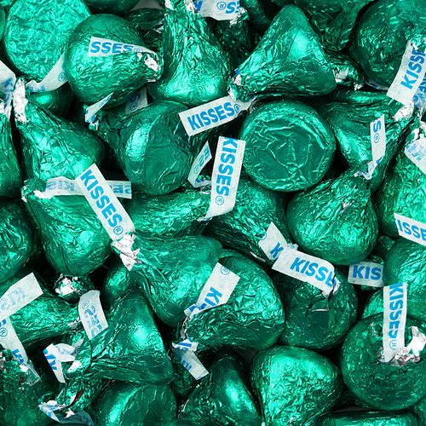
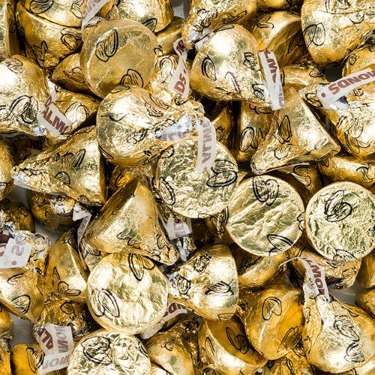
Hershey’s Kisses
Size: 50ct
Case pack: 12
Cost: $5.50
Retail: $9.99
GM %: 44.9%

Slide 8
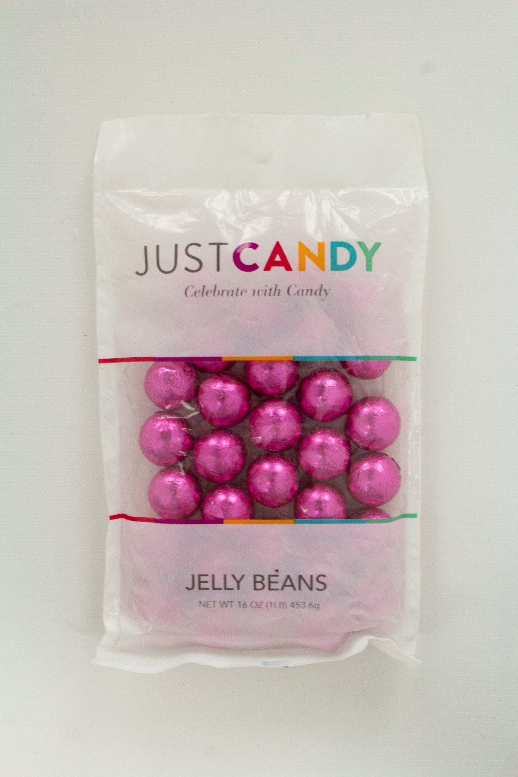
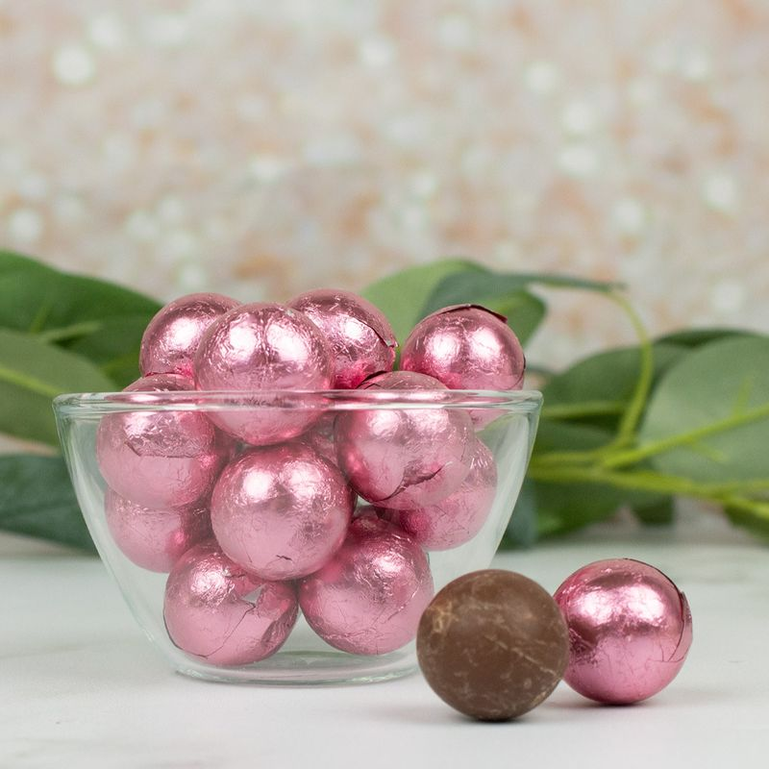
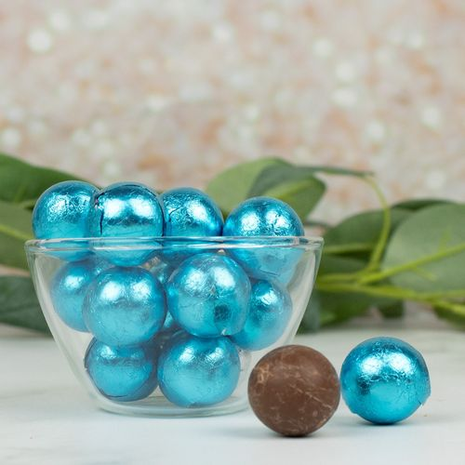
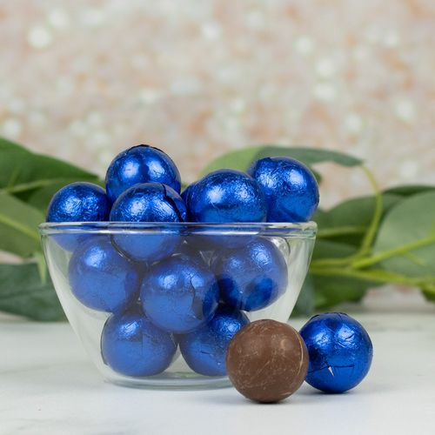
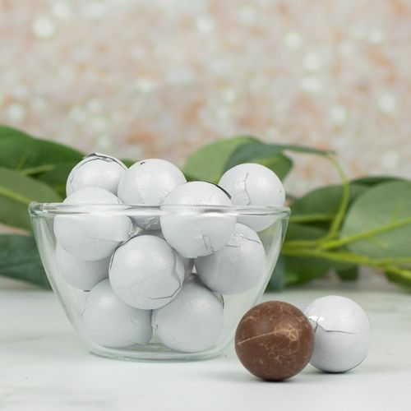
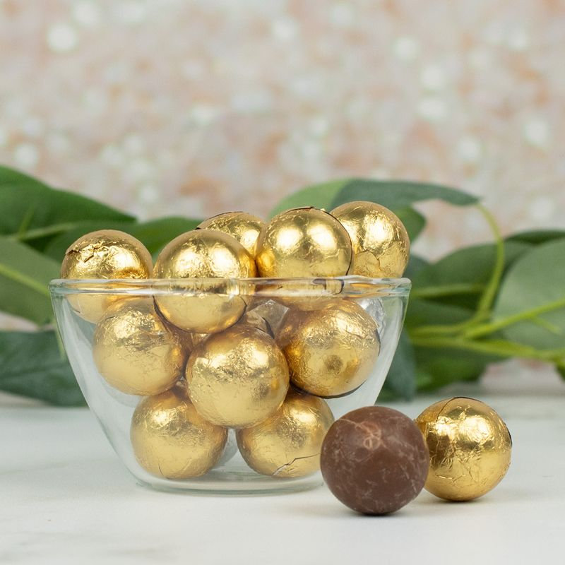
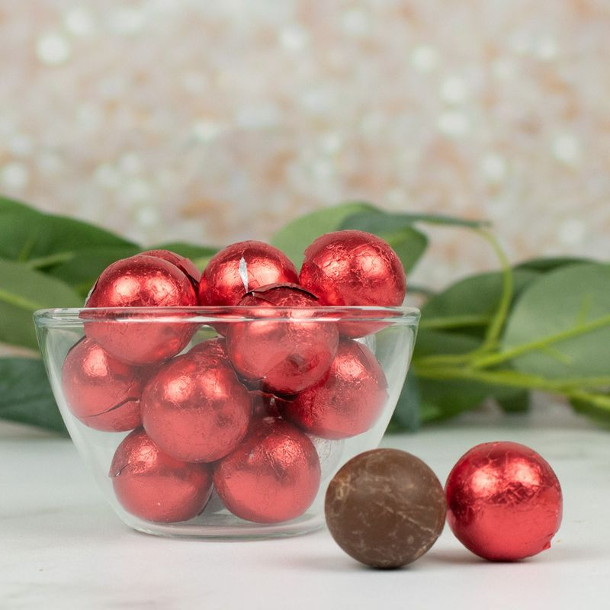




Chocolate Balls
Size: 8 ounces
Case pack: 12
Cost: $4.50
Retail: $7.99
GM %: 43.7%
Foil Chocolate Balls

Slide 9









Lollipops
Size: 40ct
Case pack: 12
Cost: $4.50
Retail: $7.99
GM %: 43.7%
Size: 130ct
Case pack: 8
Cost: $5.50
Retail: $9.99
GM %: 45%

Slide 10














Gumballs
Size: 14 ounces
Case pack: 12
Cost: $4.50
Retail: $7.99
GM %: 43.7

Slide 11

Peanut Butter Cups
Size: 8 ounces
Case pack: 12
Cost: $4.00
Retail: $7.99
GM %: 50%

Slide 12

Chocolate Coins
Size: 6 ounces
Case pack: 12
Cost: $6.00
Retail: $9.99
GM %: 40.0%

Slide 13





Jordan Almonds
Size: 12 ounces
Case pack: 12
Cost: $4.50
Retail: $7.99
GM %: 43.7%

Slide 14





Gummy Rings
Size: 12 ounces
Case pack: 12
Cost: $4.50
Retail: $7.99
GM %: 43.7%

Slide 15













Wrapped Hershey’s Miniatures
Size: 20 ct
Case pack: 12
Cost: $4.50
Retail: $7.99
GM %: 43.7%

