Slide 1
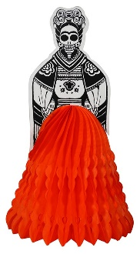
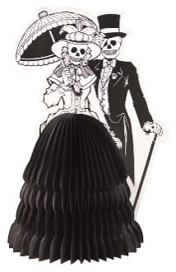
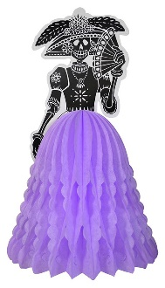
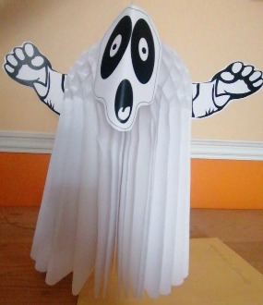
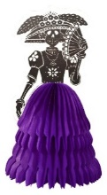
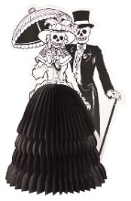
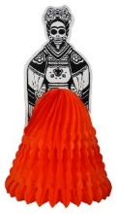
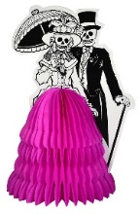
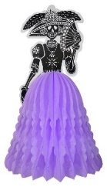
Honeycomb Centerpieces
100-500001-9
9” Frida Centerpiece
Pack: 48
Assorted Colors
100-500002-9
9” DOD Couple
Pack: 48
Assorted Colors
100-500003-9
Lady with Fan
Pack: 48
Assorted Colors
100-50000X-9
9” Pumpkin
Pack: 48
100-50000X-9
9” Ghost
Pack: 48
100-500001-14
14” Frida Centerpiece
Pack: 48
Assorted Colors
100-500002-14
14” DOD Couple
Pack: 48
Assorted Colors
100-500003-14
14” Lady with Fan
Pack: 48
Assorted colors
100-50000X-14
14” Pumpkin
Pack: 48
100-50000X-9
14” Pumpkin
Pack: 48
Small: $2.00
Large: $4.00
Colors Available:

Slide 2
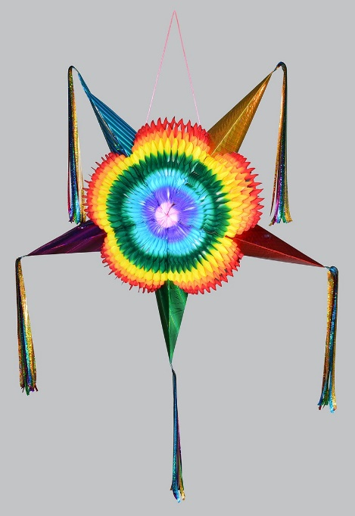
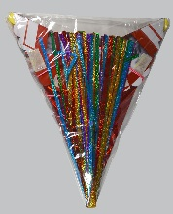
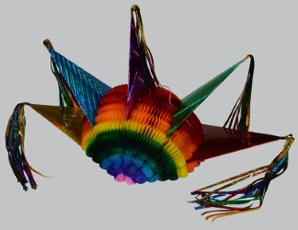
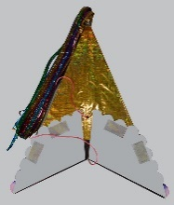
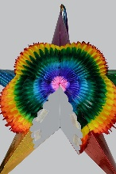
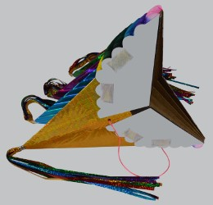
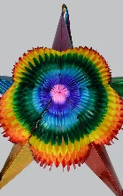
Jumbo Pop-Up Piñata
Pop Up Piñata folds flat for shipping and Storage
Retail package size is 18” L x 14” W x 1” D
Easy to display and saves shelf space and freight
Easy assembly
Velcro closure allow Piñata to be set up and taken down multiple times
Unfolds to 36” Jumbo size
Hand-dyed so custom colors/combinations are available
$22.00 ea
FOB El Paso
Remove from Retail package
Unfold halfway to use as a table decoration
Begin set up by unfolding section by section
Continue to unfold
Continue to Carefully unfold
Completely unfold to Jumbo 36” size and close with Velcro

Slide 3
Handmade Paper Banners
Two sizes: Large (18” tall) and Medium (14” tall)
Two materials: Paper or Vinyl
10 Panels per Banner
Assorted Colors
15’ long
Everyday
Halloween
Day of the Dead
Christmas
Easter
Fiesta San Antonio
Cinco de Mayo
Vinyl Banners
Medium: $3.50
Large: $4.00
Paper Banners
Medium: $3.05
Large: $3.50

